Slide 1
West End Stakeholder Meeting
February 25, 2018

Slide 2
Agenda
Where are we?
  What have we established so far?
What do we still need?
  How Much Revenue will your district collect?
  Estimated Project Costs
Action Plan
  Scheduling your first community meeting

Slide 3
Where are we now?

Slide 4
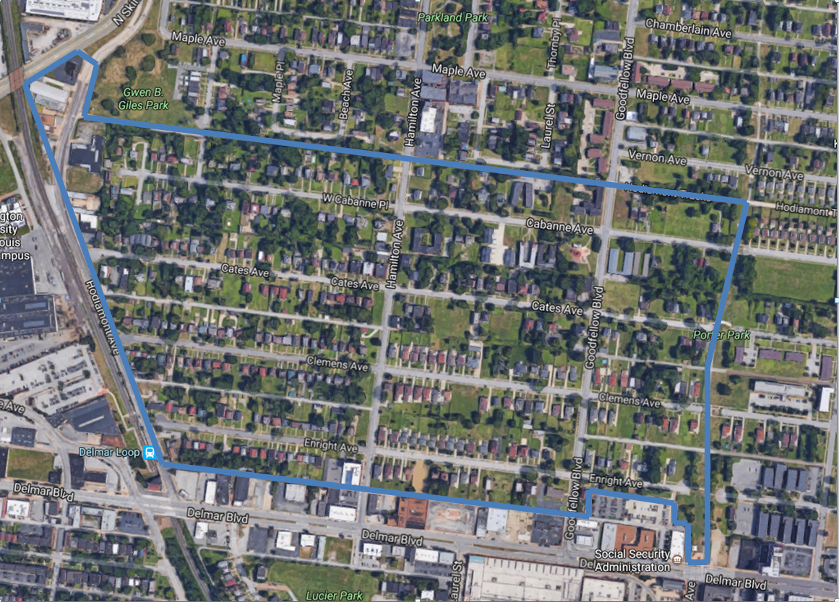
What We’ve established so far
District Boundaries

Slide 5
What We’ve Established So Far
Top Priorities
  Public Safety (security enhancements and patrols, traffic calming)
  Pedestrian and Street Maintenance (sidewalks, alleys, ramps, streetlights)
  Cleaning (litter pick-up, street cleaning, graffiti removal)
  Landscaping (lawns, trees, and flowers)

Slide 6
What do we still need?

Slide 7
What Do We Still Need?
Determining your special assessment
  The amount that residents will pay into the district
Two approaches to collect special assessment
  Method 1: Based on assessed valuation of property (Special Business Districts use this method)
  Method 2: Create your own special assessment criteria

Slide 8
Determining the Special Assessment

Slide 9
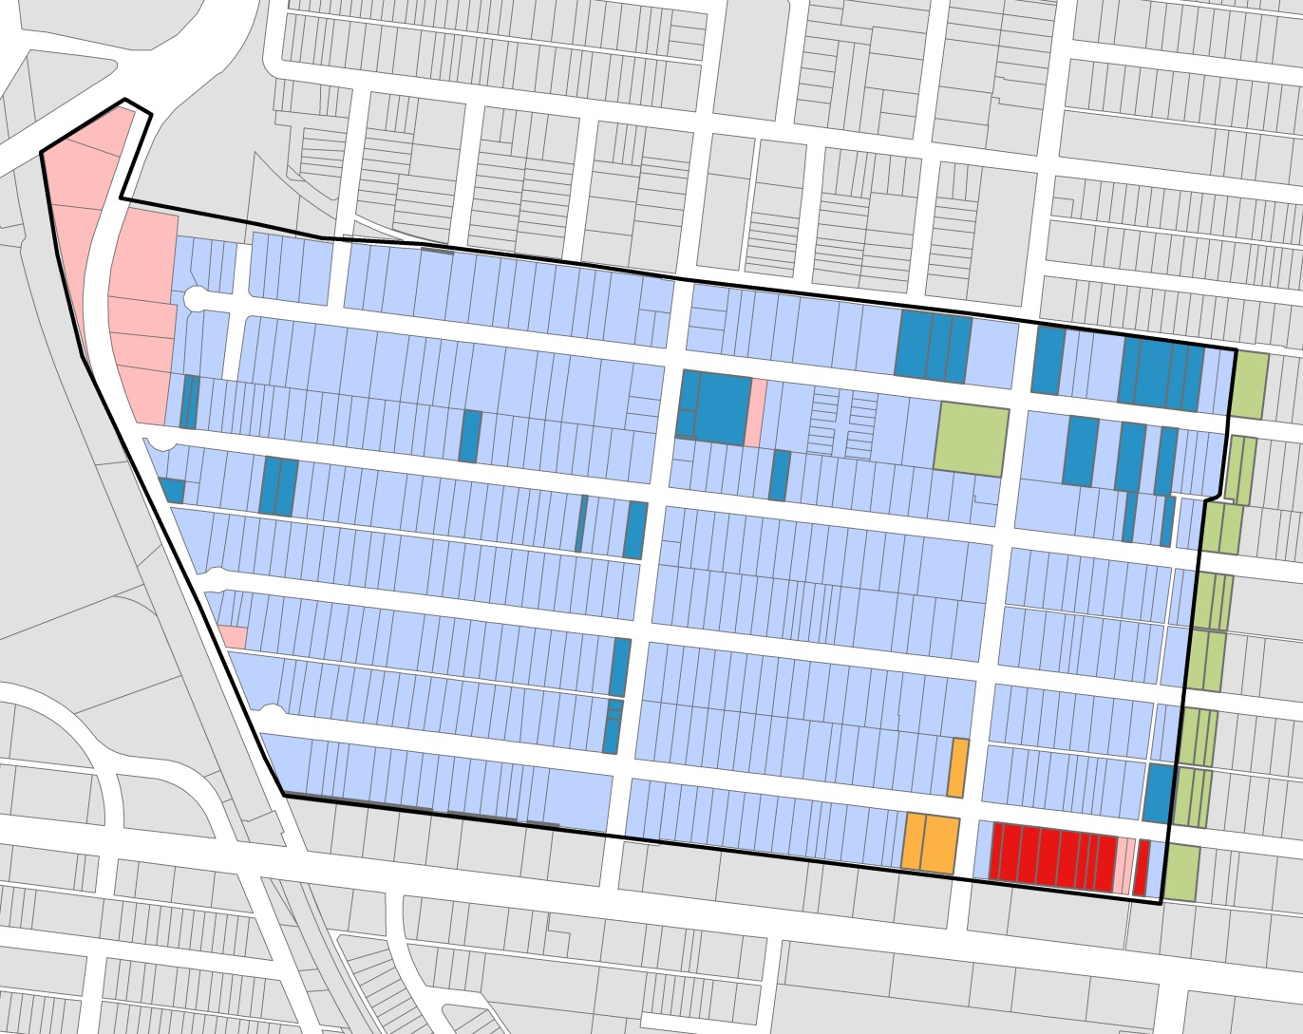
West End Property Types
- Residential
- Commercial
Tax Exempt Properties
- Park
- LRA
- Non-Profit
- Church
- West End CID

Slide 10
Method 1
Collect revenue based on assessed valuation of property
  In the City of St. Louis, residential property taxes are assessed at 19% of a home’s appraised value
  Commercial property real estate tax is assessed at 32% of appraised value
  Maximum collection: .85cents per $100 of property’s assessed value
  Tax abated property pay based on the pre-development value of the property during the tax abatement period

Slide 11
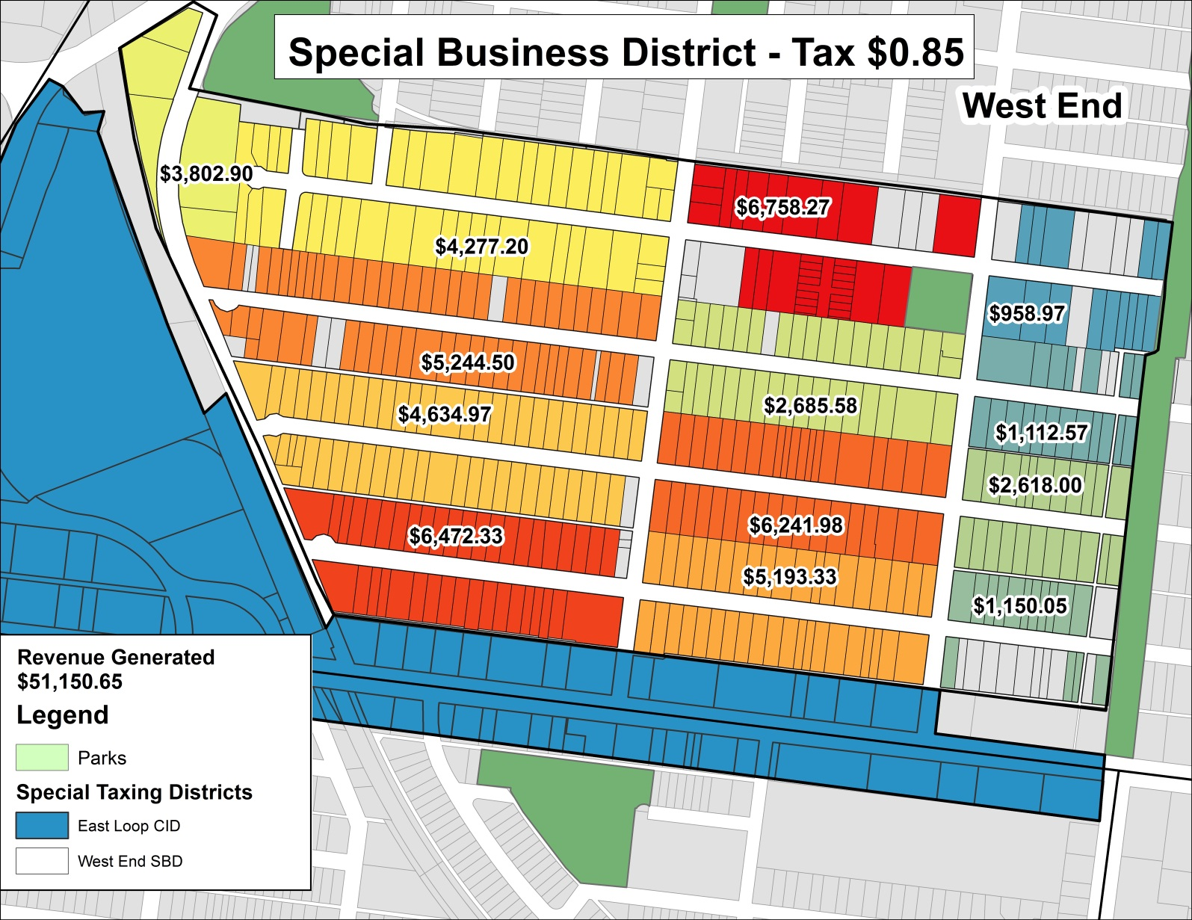
Revenue Map at $.85

Slide 12
59XX Clemens
$36,800
Property appraised value
$6,992
City assessed value
$59.43
Additional tax per year
Assessed value is 19% of Appraised Value
$4.95 per month
Based on City of St. Louis Public Tax Records

Slide 13
60XX Cates
$47,700
Property appraised value
$9,063
City assessed value
$77.04
Additional tax per year
Assessed value is 19% of Appraised Value
$6.41 per month
Based on City of St. Louis Public Tax Records

Slide 14
Method 2
Create your own special assessment criteria
  Based on type of home or square footage of home

Slide 15
West End CID
 |  | Tax | # | Revenue Total
Exempt |  | $ - | 65 | $ -
Residential | Single Family | $ 200.00 | 357 | $ 71,400.00
 | Multi Family | $ 150.00 | 366 | $ 54,900.00
Commercial |  | $ 300.00 | 11 | $ 3,300.00
SUM Total |  |  |  | $ 129,600.00

Slide 16
West End CID
 |  | Tax | # | Revenue Total
Exempt |  | $ - | 65 | $ -
Residential | Single Family | $ 200.00 | 357 | $ 71,400.00
 | Multi Family | $ 250.00 | 366 | $ 91,500.00
Commercial |  | $ 300.00 | 11 | $ 3,300.00
SUM Total |  |  |  | $ 166,200.00

Slide 17
West End CID
 |  | Tax | # | Revenue Total
Exempt |  | $ - | 65 | $ -
Residential | Single Family | $ 150.00 | 357 | $ 53,550.00
 | Multi Family | $ 100.00 | 366 | $ 36,600.00
Commercial |  | $ 200.00 | 11 | $ 2,200.00
SUM Total |  |  |  | $ 92,350.00

Slide 18
West End CID
 |  | Tax | # | Revenue Total
Exempt |  | $ - | 65 | $ -
Residential | Single Family | $ 150.00 | 357 | $ 53,550.00
 | Multi Family | $ 200.00 | 366 | $ 73,200.00
Commercial |  | $ 200.00 | 11 | $ 2,200.00
SUM Total |  |  |  | $ 128,950.00

Slide 19
West End CID
 |  | Tax | # | Revenue Total
Exempt |  | $ - | 65 | $ -
Residential | Single Family | $ 200.00 | 297 | $ 59,400.00
 | Multi Family | $ 150.00 | 354 | $ 53,100.00
 | Vacant | $ 100.00 | 56 | $ 5,600.00
Commercial |  | $ 300.00 | 11 | $ 3,300.00
SUM Total |  |  |  | $ 121,400.00
* One vacant 12 unit multi family property

Slide 20
West End CID
 |  | Tax | # | Revenue Total
Exempt |  | $ - | 65 | $ -
Residential | Single Family | $ 200.00 | 297 | $ 59,400.00
 | Multi Family | $ 250.00 | 354 | $ 88,500.00
 | Vacant | $ 100.00 | 56 | $ 5,600.00
Commercial |  | $ 300.00 | 11 | $ 3,300.00
SUM Total |  |  |  | $ 156,800.00
* One vacant 12 unit multi family property

Slide 21
West End CID
 |  | Tax | # | Revenue Total
Exempt |  | $ - | 65 | $ -
Residential | Single Family | $ 150.00 | 297 | $ 44,550.00
 | Multi Family | $ 100.00 | 354 | $ 35,400.00
 | Vacant | $ 75.00 | 56 | $ 4,200.00
Commercial |  | $ 200.00 | 11 | $ 2,200.00
SUM Total |  |  |  | $ 86,350.00
* One vacant 12 unit multi family property

Slide 22
West End CID
 |  | Tax | # | Revenue Total
Exempt |  | $ - | 65 | $ -
Residential | Single Family | $ 150.00 | 297 | $ 44,550.00
 | Multi Family | $ 200.00 | 354 | $ 70,800.00
 | Vacant | $ 75.00 | 56 | $ 4,200.00
Commercial |  | $ 200.00 | 11 | $ 2,200.00
SUM Total |  |  |  | $ 121,750.00
* One vacant 12 unit multi family property

Slide 23
West End CID
 |  | Tax | # | Revenue Total
Exempt |  | $ - | 65 | $ -
Residential | Single Family | $ 100.00 | 297 | $ 29,700.00
 | Multi Family | $ 100.00 | 354 | $ 35,400.00
 | Vacant | $ 75.00 | 56 | $ 4,200.00
Commercial |  | $ 200.00 | 11 | $ 2,200.00
SUM Total |  |  |  | $ 71,500.00
* One vacant 12 unit multi family property

Slide 24
West End CID
 |  | Tax | # | Revenue Total
Exempt |  | $ - | 65 | $ -
Residential | Single Family | $ 100.00 | 297 | $ 29,700.00
 | Multi Family | $ 150.00 | 354 | $ 53100.00
 | Vacant | $ 75.00 | 56 | $ 4,200.00
Commercial |  | $ 200.00 | 11 | $ 2,200.00
SUM Total |  |  |  | $ 89,200.00
* One vacant 12 unit multi family property

Slide 25
West End CID
 |  | Tax | Total Assessment | Revenue Total
Exempt |  | $ - | - | $ -
Residential |  | 0.0085 | $4,117,510.00 | $ 34,998.84
Commercial |  | 0.0085 | $ 534,200.00 | $ 4,540.70
SUM Total |  |  |  | $ 39,539.54

Slide 26
Estimated Project Costs

Slide 27
Potential Project Costs
Projects discussed are intended to be used as a guide to help you narrow down an approach to collect the special assessment
Lacking the input of the greater community and may change
Average costs

Slide 28
DISTRICT SERVICES
Off-Duty Police Patrols
  $55 per hour per officer (bike)
  $55 per hour per officer plus fuel fee (car)
Security Cameras
  Networked cameras: Purchase and installation can cost between $1,500-$4,000 per camera
  Video Doorbells: $100-500 each
Traffic Calming
  Speed bumps $3K-$5K installed by city
  Curb bump-outs $10k-$30K

Slide 29
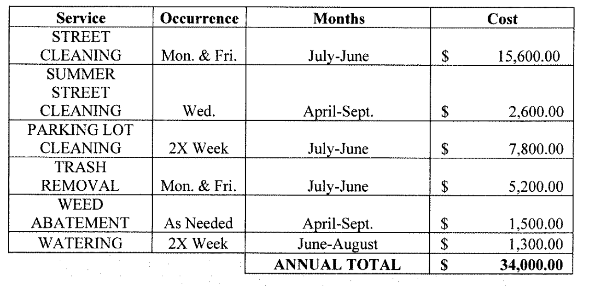
DISTRICT SERVICES
Litter Pick Up/Beautification
  Cost varies according to scope of work
  Example Service Schedule, Grove CID

Slide 30
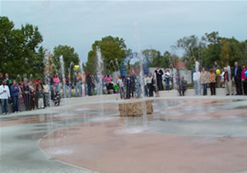
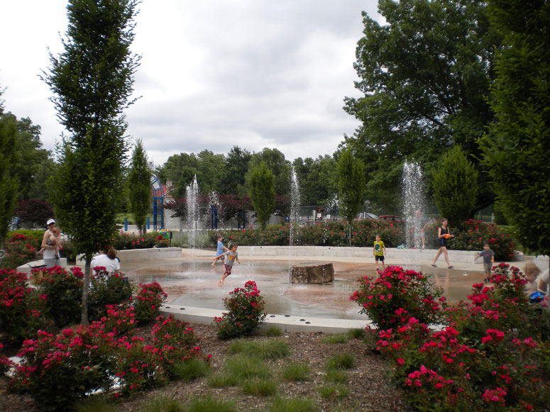
DISTRICT SERVICES
Sidewalk repair
  $10-$12 per sq ft of sidewalk to replace and repair
Murals
  $1,000-$5,000
Water Fountain, water feature
  The interactive fountain at Tilles Park cost about $25,000

Slide 31
Action Plan

Slide 32
Action Plan
Next meeting
  Vote on which special assessment approach you would like to take
Schedule first community meeting
  Decide when your first community meeting will be
  We will spend upcoming stakeholder meetings preparing for first community meeting
Set up Nonprofit
  Meet 30 minutes before or after next stakeholder meeting

