Slide 1
West End CID
Stakeholder Meeting
November 5, 2017

Slide 2
Previous Meeting Recap
Nonprofit VS. Political Subdivision
  Vote
Community Engagement
Stakeholder Check-in

Slide 3
Today’s Agenda
Nonprofit VS. Political Subdivision
  Vote
Home Owner Property Assessments
Crime Report
Community Outreach
  FAQ

Slide 4
Political Subdivision or Nonprofit?
Voting

Slide 5
What kind of CID?
The district (CID) can impose a sales tax on sales/ use tax on goods and services within proposed boundary of district and/or a special assessment
Appointments of directors are made by chief elected officer of the municipality with the consent of the governing body
  The district (CID) may only impose special assessments to finance the cost of improvements and services.
  Nonprofit must be formed and in good standing prior to filing a petition for creation
Political Subdivision
Non-Profit

Slide 6
Results So Far
Political Subdivision | Non-profit
2 | 4

Slide 7
Home Owners
Discussion on the assessed values of each parcel

Slide 8
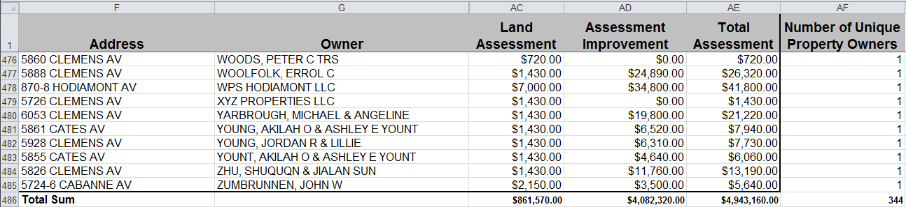
Homeowners in the neighborhood
Total Assessment= land assessment + assessment improvement
$861,570+ $4082320=$4,943,890.00
Summing the total assessment column gives us $4,943,160
  There is a $730 gap in the data from the city
  Best to go with the larger number as our safest target number ($4,943,890)
  So, we need greater than half of the total assessment
    Half of $4,943,890 is $2,471,945.00

Slide 9
Crime Report
West End Crime Statistics

Slide 10
Summary Notes: West End September 2017
75 Total Crimes
  This is a 50% increase from September 2016 (50 crimes).
    There were decreases in arson, auto theft, homicide, and rape. There were increases in assault, burglary, larceny, and robbery.
    There were a total of 20 crimes against persons (10 assaults, 1 rape, and 9 robberies).
    There were 16 crimes against persons in September 2016.
  Crime was most frequent on Tuesday and Wednesday.
There have been 409 crimes so far in 2017.
  This is a 10.54% increase compared to this point in 2016 (370 crimes).
    There were decreases in arson, auto theft, and robbery. There were increases in assault, burglary, homicide, and larceny.
  There have been 127 crimes against persons so far in 2017, compared to 102 crimes against persons at this point in 2016, which is a 24.51% increase.

Slide 11
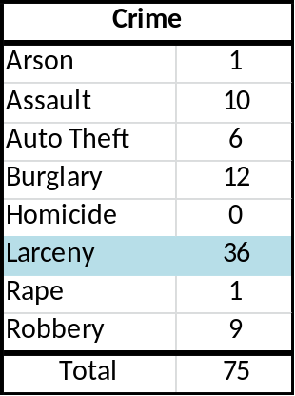
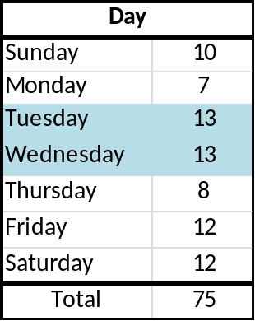
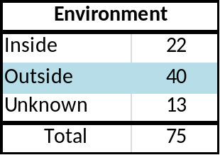
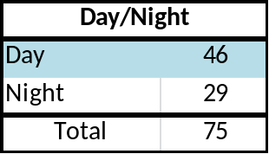
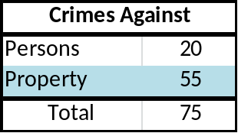
West End: September 2017

Slide 12
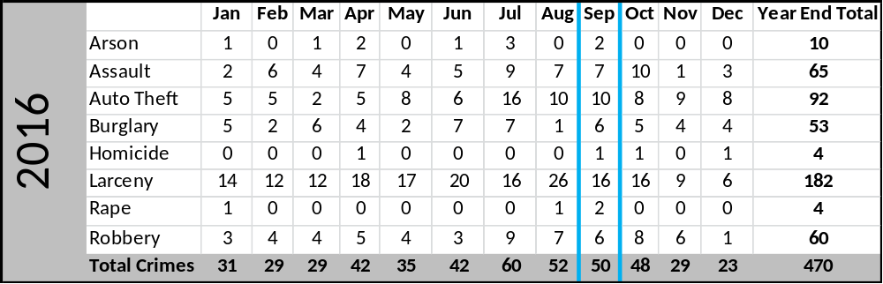
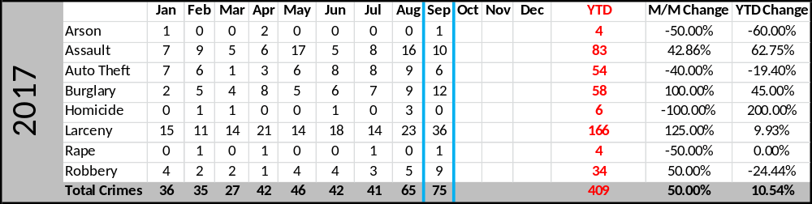
WE: Comparing 2016 and 2017

Slide 13
Community Outreach
FAQ

Slide 14
Frequently Asked Questions
Creating your “cheat sheet”
Draft Questions
  What is a Community Improvement District?
  Why do we need a CID?
  How is a CID created?
  Who can sign a CID petition?
  Who will govern the CID?
  What will property owners have to pay?
  If the CID passes, will city services decrease?
What questions are missing?

