Slide 1
West End Stakeholder Meeting
September 17, 2017

Slide 2
Review of Last Meeting
Establishing Ground Rules
SBD or CID?
Community Outreach Strategy
Expanding Stakeholder Group

Slide 3
This Meeting
SBD or CID?
What’s Next?
  Confirming Boundaries
  District Services
  Community Engagement

Slide 4
SBD or CID?

Slide 5
Type of District
CID
SBD
WHICH TYPE OF DISTRICT IS BEST FOR YOUR NEIGHBORHOOD?

Slide 6
CID versus sbd
CID
SBD
Can be organized as a non-profit or political subdivision.
Created through a petition process.
Can levy both sales/use taxes as well as special assessments.
Minimum of 3 board members.
Hancock Amendment does not apply.
Use of funding very flexible.
Is organized as a political subdivision.
Created through a public election.
Can levy a property tax.
Mandatory 7 board members.
Hancock Amendment does apply.
Use of funding very restrictive.

Slide 7
What’s Next?

Slide 8
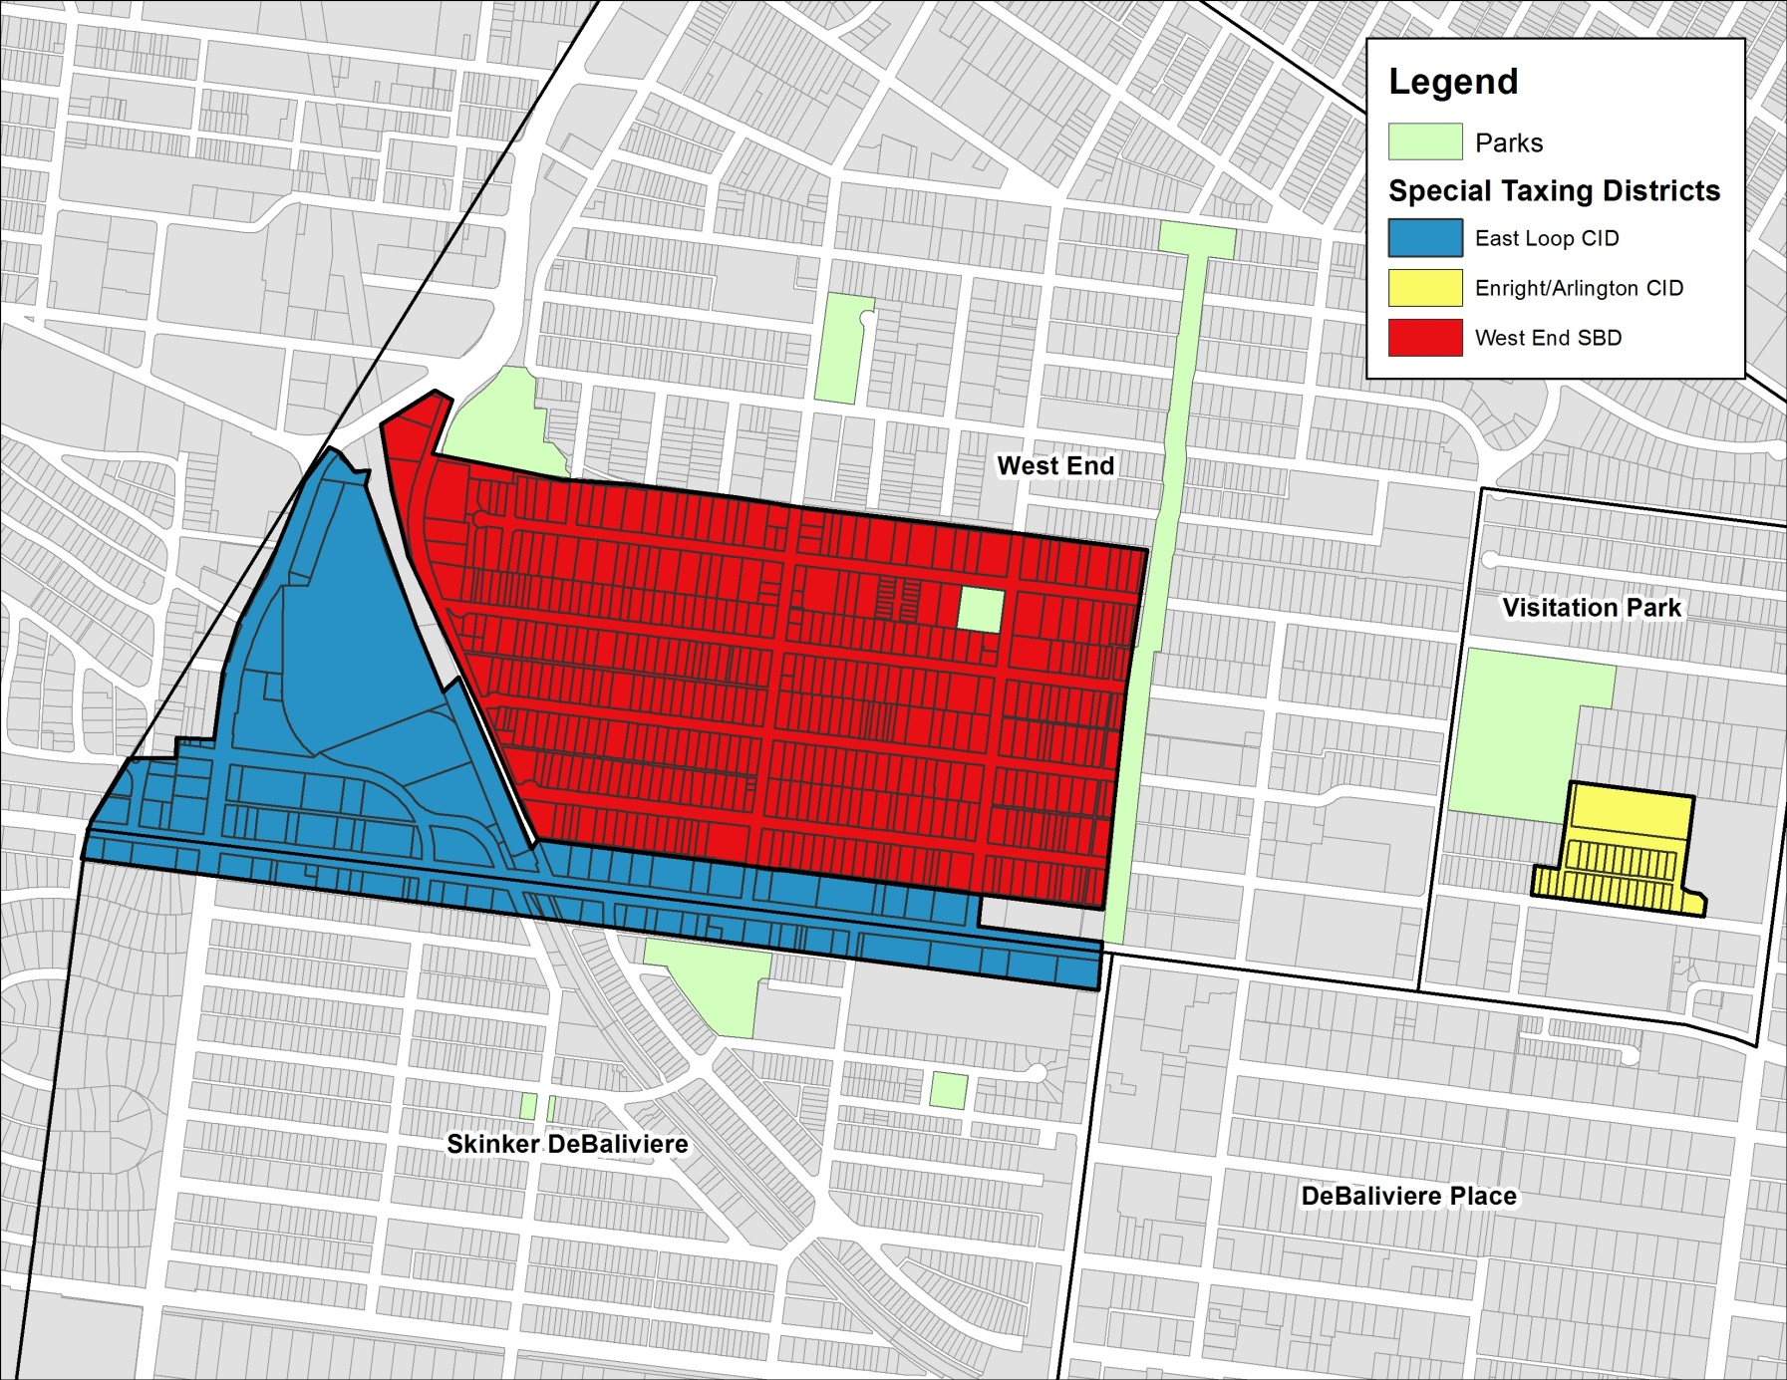
Proposed Boundary

Slide 9
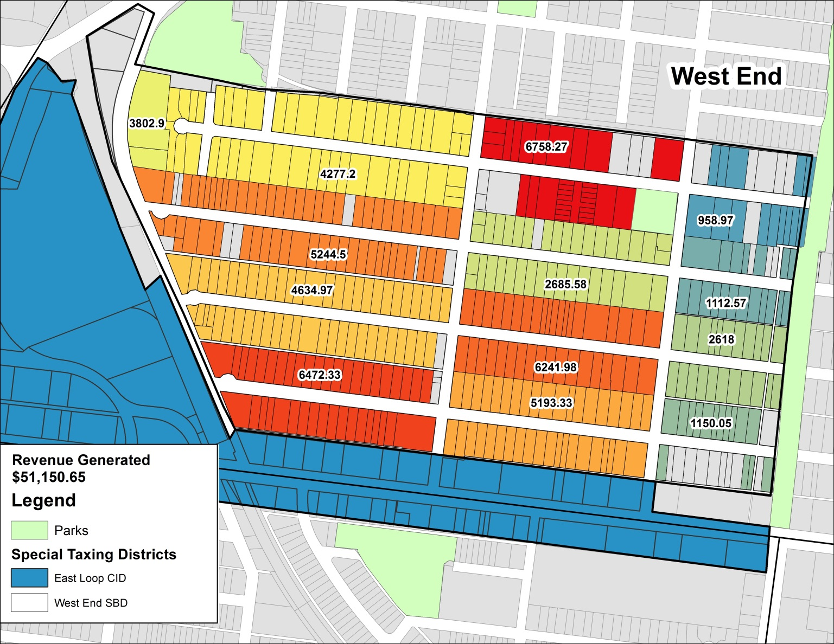
Proposed District Revenue

Slide 10
District Boundary Requirements
The proposed district’s boundary must be contiguous.
Individual parcel boundaries are assumed to run from the center line of the street to the center line of the alley (if there’s an alley).
The proposed boundary must be included in the ordinance that creates the district and is usually in the form of a meets and bounds survey (there will be a cost associated with this).

Slide 11
What Can Drive Your Border?
Common Area Identity
Community/Social Impact
Economy of Scale/Budget
Political Opportunities/Challenges

Slide 12
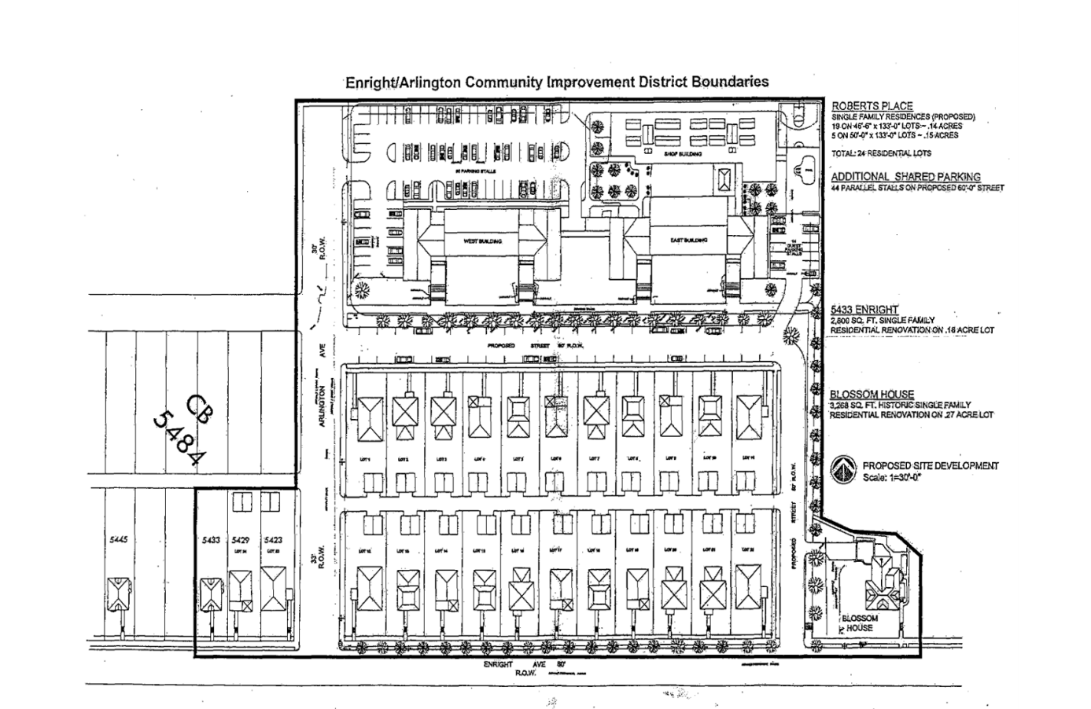
Enright/ Arlington CID

Slide 13
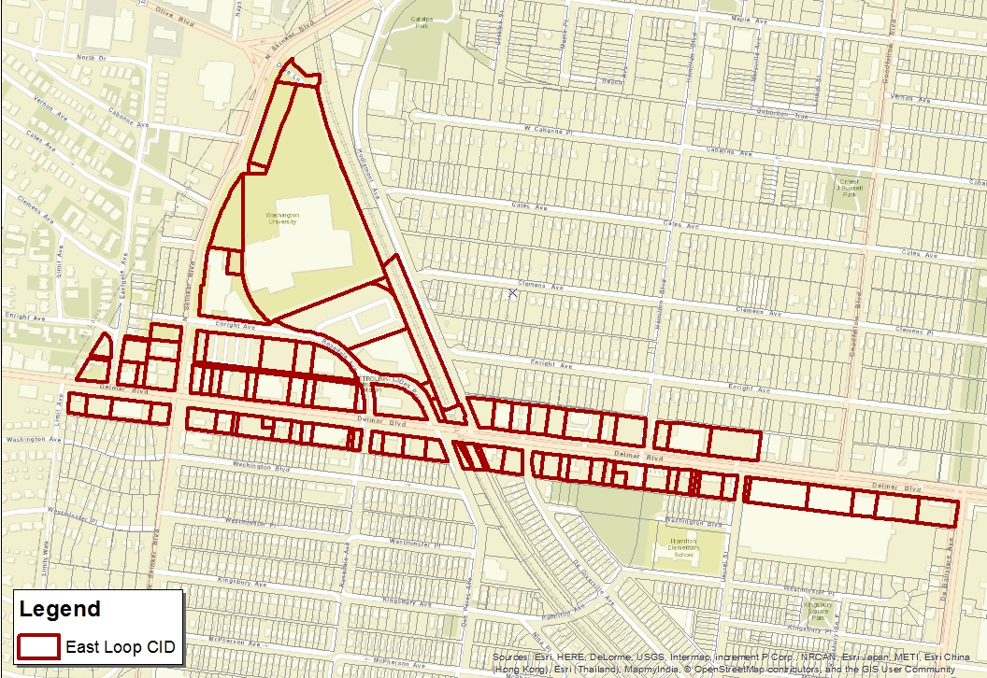
East Loop CID
Located between Washington Blvd and south of the interception of Olive and Skinker Blvd
$450,00 operating budget

Slide 14
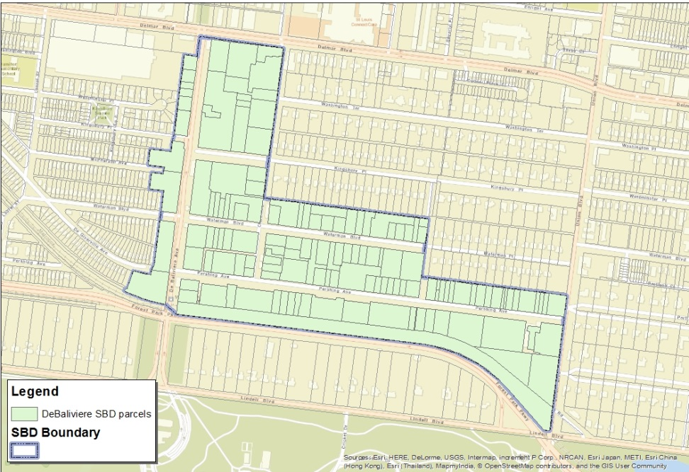
DeBaliviere Place SBD
Located just north of Forest Park between Union and DeBaliviere
Annual Operating Budget of $309,000

Slide 15
District Services

Slide 16
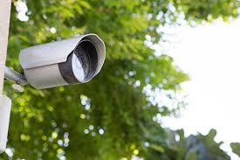

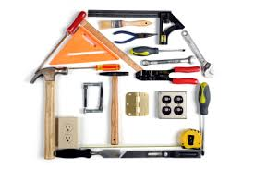
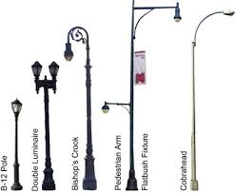
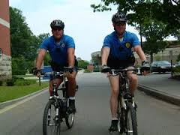
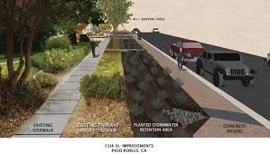
DISTRICT SERVICES
WHAT TYPE OF SERVICES WILL OUR DISTRICT PROVIDE?

Slide 17
What are the other SBDs and CIDs doing?
East Loop, New CID (Newly Established)
  $450,000 annual budget
Euclid North CID
  $800,000 annual budget
Euclid South CID
  $348,000 annual budget

Slide 18
Euclid South Cid
Beautification
  twice weekly care and watering of the District’s planters and trees. The maintenance includes a matching schedule for regular cleaning of the sidewalk and streets, emptying curbside trash containers, plus upkeep of the street furniture and lighting.
Marketing
  The CID launched phase one of its marketing and communication strategy by activating a social media campaign with the creation of CWE Live Twitter, Instagram and Facebook accounts.
Public Safety
  The Euclid South CID established the Guide Program in February 2016. These well-trained officers work in conjunction with off-duty police officers contracted by the CWE South Special Business District.
Infrastructure
  The $7M Euclid Streetscape Project is a multi-phased plan to thoroughly upgrade the public realm along Euclid, Lindell Boulevard to Forest Park Avenue. All new sidewalks, pedestrian streetlights, and trees will provide a stronger sense of place

Slide 19
Cathedral Square SBD
Beautification
  In cooperation with Gateway Greening the garden at Maryland and Boyle was improved thanks to several members of the CSSBD. Through a grant with Gateway Greening the SBD was able to spruce up the overgrown garden.
Public Safety
  Residents along Newstead noticed that north-bound traffic was moving way too fast. SBD installed roundabouts on Waterman and Lake to slow traffic.

Slide 20
DISTRICT SERVICES
Off-Duty Police Patrols
  $55 per hour per officer (bike)
  $55 per hour per officer plus fuel fee (car)
Security Cameras
  Purchase and installation can cost between $1,500-$4,000 per camera
Traffic Calming
  Speed bumps $3K-$5K installed by city
  Curb bump-outs $10k-$30K
Litter Pick Up/Beautification
  Cost varies according to scope of work

Slide 21
DISTRICT SERVICES
How will you determine what type of services that your district will provide?
  Budget should address needs highlighted in the petition

Slide 22
Community Engagement

Slide 23
Community Engagement
Finding additional stakeholder
  Need a representative from each block
  Where are we on this effort?
Engaging the larger community
  Collecting feedback
    Surveys
    Community Meetings
      Monthly

