Slide 1
West End CID Stakeholder Meeting
October 1, 2017

Slide 2
Previous Meeting Recap
  Boundaries
    District boundaries confirmed
  Type of District
    Unanimous vote to pursue CID
  Community Engagement
    Expansion of stakeholder group

Slide 3
Today’s Agenda
Organizing a CID
Community Engagement
Special Assessment Scenarios

Slide 4
Organizing a CID

Slide 5
Missouri Revised Statutes
Missouri Revised Statutes
Chapter 67
67.1401-67.1571
Political Subdivisions, Miscellaneous Powers
http://revisor.mo.gov/main/Home.aspx

Slide 6
Types of CIDs
There are two main types of CIDs in Missouri:
  1. Political subdivisions (which are funded by public money via sales tax assessments)
  2. Not-for-profits (which are funded by special assessments)
    Special Assessment: A real property tax proportionately levied on homeowners and property owners to cover the costs of improvements that will be for the benefit of all upon whom it is imposed.

Slide 7
Organizing a CID
Creation of nonprofit corporation or
If the district is to be created as a nonprofit corporation, the corporation must be formed and in good standing prior to filing a petition for creation.
Initial Petition
Creation by ordinance of the governing body upon petition signed by:
Property owners collectively owning more than 50% of the assessed value of the real property within the proposed district; and more than 50% per capita of all owners of real property within the proposed district.
Verification of Petition
The municipal clerk must verify, within 90 days after filing, whether the petition meets the requirements of the Act.
Public Hearing
Hold a public hearing regarding the formation of the district
Establishment by ordinance
Ordinance is established

Slide 8
Creation of Nonprofit Corporation
1. Choose who will be the initial directors on your board
  In Missouri, your nonprofit corporation must have three or more directors.
2. Choose a name for your Missouri nonprofit corporation
3. Prepare and file your nonprofit articles of incorporation
  You will need to create and file nonprofit articles of incorporation with the Missouri Secretary of State’s office. The articles of incorporation contain basic information about your nonprofit, including:
    its name
    whether it is a public benefit or mutual benefit corporation
    the street address of its initial registered office and the name of its initial registered agent at that office
    the name and address of each incorporator
    whether it will have members, and
    a statement regarding distribution of assets upon dissolution

Slide 9
Creation of Nonprofit Corporation
4. Prepare bylaws for your Missouri nonprofit corporation
  You'll need to prepare bylaws that comply with Missouri law and contain the rules and procedures your corporation will follow for holding meetings, electing officers and directors, and taking care of other corporate formalities required in Missouri. Your bylaws do not need to be filed with the Missouri Secretary of State -- they are your internal operating manual
5. Hold a meeting of your board of directors
  Conduct your Missouri nonprofit corporation’s first meeting. The top priorities of this meeting should be to appoint and elect officers and directors, and to adopt your nonprofit corporation’s bylaws.
6. Apply for 501(C)(3) status
  Apply for established nonprofit to be tax-exempt

Slide 10
Creation of Political Subdivision
Created after the petition process when ordinance has been successfully established, similar to a municipality
No nonprofit application process

Slide 11
What’s the difference?
Political subdivision
  If the CID is organized as a political subdivision, the District can impose a sales tax on most retail sales and/or a real property tax.
  Appointment of directors.
    Appointments are made by chief elected officer of the municipality with the consent of the governing body.
Nonprofit
  If the CID is organized as a non-profit corporation, it may only impose special assessments to finance the cost of improvements and services.
  Nonprofit must be formed and in good standing prior to filing a petition for creation.

Slide 12
Petition
The district is created by petition, signed by property owners owning at least 50% of the assessed value of the real property, and more than 50% per capita of all owners of real property within the proposed CID
Presented for authorizing ordinance to the governing body of the local municipality in which the proposed CID would be located.

Slide 13
Petition
Petition must include a wide variety of information, including:
  a. Name of the proposed district, which must include “Community Improvement District” as part thereof.
  b. Legal description and boundary map.
  c. A five-year plan describing the purposes of the proposed district, the services it will provide, the improvements it will make and an estimate of costs of those services and improvements.
  d. Organizational and governance information, including:
    i. Whether the district will be a political subdivision or a nonprofit corporation.
    ii. If a political subdivision, the manner in which the board of directors will be established (either by election or appointment) and the number of directors on the initial board of directors.
  e. The maximum rates of real property taxes, business license taxes and special assessments that may be imposed.
  f. The limitations, if any, on the borrowing capacity and revenue generation of the district.
  g. Notice that names of signers may not be withdrawn later than seven days after petition filed.

Slide 14
Public Hearing
  1. Must be held within 45 days of governing body’s receipt of verified petition.
  2. Notice must be published once a week for two consecutive weeks
  immediately prior to the week of the public hearing.
  3. Notice must be mailed to property owners at least 15 days prior to the
  public hearing.
  4. Notices must include the following information:
  a. Date, time and place of hearing.
  b. Statement that a petition for the establishment of a district has
  been filed.
  c. Boundaries of the district by street location and map.
  d. Statement that a copy of the petition is available for review at the
  clerk’s office during regular business hours.
  e. Statement that all interested persons will be given an opportunity
  to be heard at the hearing.

Slide 15
Community Engagement

Slide 16
Community Engagement
First Steps
  Have we identified enough stakeholder to begin engaging other community members?
  What will your first step in engaging the community be?
  When will this first engagement occur?

Slide 17
Special Assessment Scenarios

Slide 18
CID Analysis
Initial Numbers may be subject to minor errors in Tax Assessor’s File
Data obtained from St. Louis City Open Data Website (http://dynamic.stlouis-mo.gov/citydata/downloads) – 9/21/2017
Property type determine by Assessor’s Class use code
  100 Individual
  200 company
Classified as exempt if property ownership is:
  St. Louis Parks
  Church
  Non-Profit
  LRA or LCRA

Slide 19
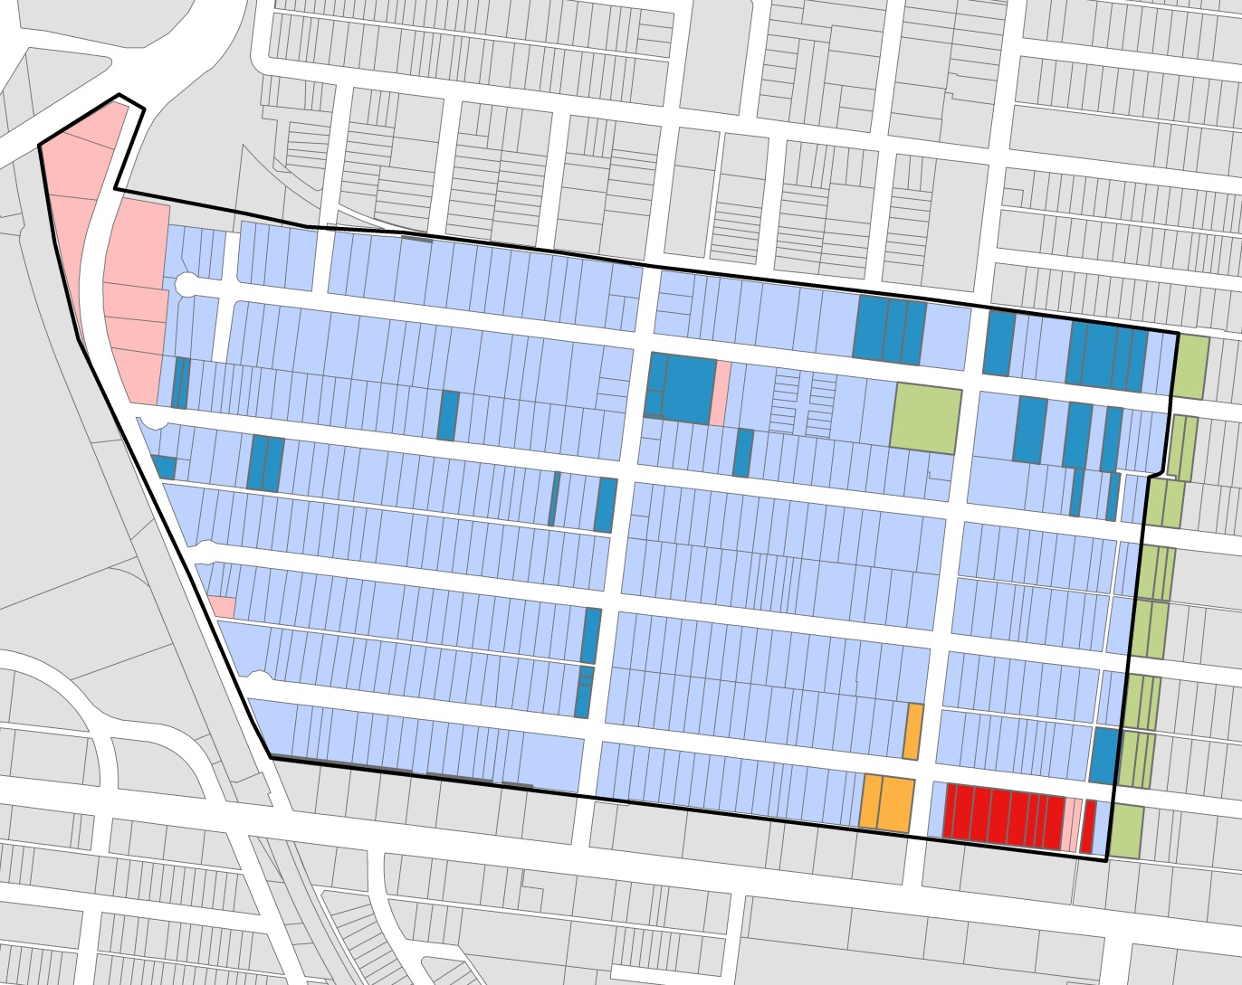
West End Property Types
- Residential
- Commercial
Tax Exempt Properties
- Park
- LRA
- Non-Profit
- Church
- West End CID

Slide 20
West End CID
 |  | Tax | # | Revenue Total
Exempt |  | $ - | 65 | $ -
Residential | Single Family | $ 200.00 | 357 | $ 71,400.00
 | Multi Family | $ 150.00 | 366 | $ 54,900.00
Commercial |  | $ 300.00 | 11 | $ 3,300.00
SUM Total |  |  |  | $ 129,600.00

Slide 21
West End CID
 |  | Tax | # | Revenue Total
Exempt |  | $ - | 65 | $ -
Residential | Single Family | $ 150.00 | 357 | $ 53,550.00
 | Multi Family | $ 100.00 | 366 | $ 36,600.00
Commercial |  | $ 200.00 | 11 | $ 2,200.00
SUM Total |  |  |  | $ 92,350.00

Slide 22
West End CID
 |  | Tax | # | Revenue Total
Exempt |  | $ - | 65 | $ -
Residential | Single Family | $ 200.00 | 297 | $ 59,400.00
 | Multi Family | $ 150.00 | 354 | $ 53,100.00
 | Vacant | $ 100.00 | 56 | $ 5,600.00
Commercial |  | $ 300.00 | 11 | $ 3,300.00
SUM Total |  |  |  | $ 121,400.00
* One vacant 12 unit multi family property

Slide 23
West End CID
 |  | Tax | # | Revenue Total
Exempt |  | $ - | 65 | $ -
Residential | Single Family | $ 150.00 | 297 | $ 44,550.00
 | Multi Family | $ 100.00 | 354 | $ 35,400.00
 | Vacant | $ 75.00 | 56 | $ 4,200.00
Commercial |  | $ 200.00 | 11 | $ 2,200.00
SUM Total |  |  |  | $ 86,350.00
* One vacant 12 unit multi family property

Slide 24
West End CID
 |  | Tax | # | Revenue Total
Exempt |  | $ - | 65 | $ -
Residential | Single Family | $ 100.00 | 297 | $ 29,700.00
 | Multi Family | $ 100.00 | 354 | $ 35,400.00
 | Vacant | $ 75.00 | 56 | $ 4,200.00
Commercial |  | $ 200.00 | 11 | $ 2,200.00
SUM Total |  |  |  | $ 71,500.00
* One vacant 12 unit multi family property

Slide 25
West End CID
 |  | Tax | Total Assessment | Revenue Total
Exempt |  | $ - | - | $ -
Residential |  | 0.0085 | $4,117,510.00 | $ 34,998.84
Commercial |  | 0.0085 | $ 534,200.00 | $ 4,540.70
SUM Total |  |  |  | $ 39,539.54

